Slide 1
Correcting False memories in the drift paradigm
Paul M. Guinther, Ph.D.
Portland Psychotherapy Clinic, Research, & Training Center
Michael J. Dougher, Ph.D.
University of New Mexico, Department of Psychology
Paper presentation for the
2012 ACBS World Conference X

Slide 2
The Deese-Roediger-McDermott (DRM) Paradigm and False Memories

Slide 3
Cognitive Account of False Memory

Slide 4
Behavior Analytic Account of False Memory

Slide 5
Derived Relational Intrusions Following Training (DRIFT) Paradigm Guinther & Dougher, JEAB 2010

Slide 6
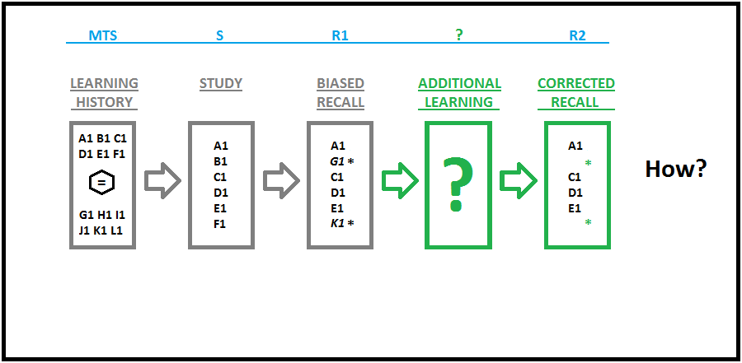
Correcting False Memories

Slide 7
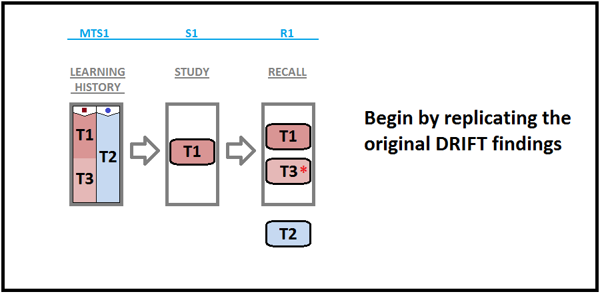
Experiment I: Design & Intended Effects

Slide 8
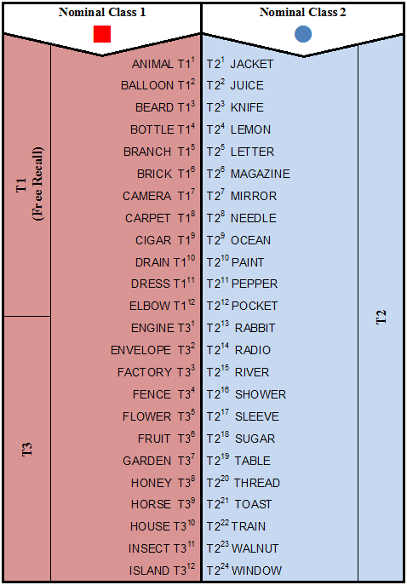
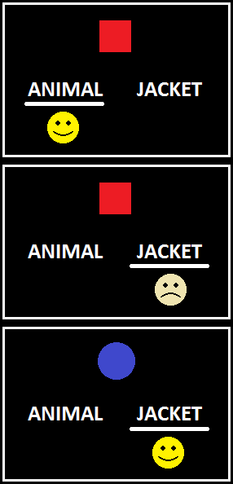
MTS1 Training

Slide 9
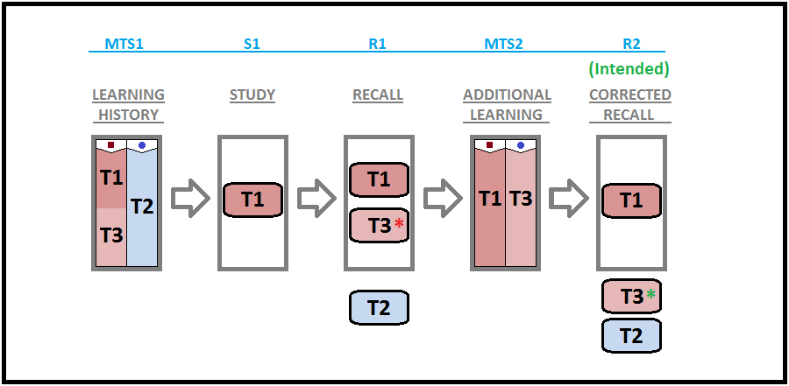
Extend the DRIFT paradigm to correct the false memories:

Slide 10
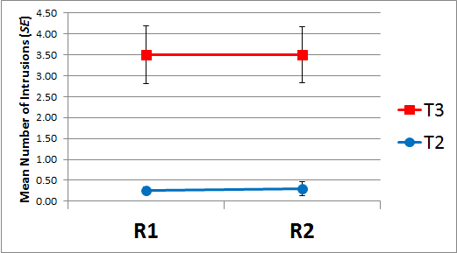
Experiment I: Results
Time x Type of Intrusion
F(1, 9) = .012, p = .915, η_{p}² ⁼ .001

Slide 11
Why Didn’t the Additional Learning Correct the False Memories?
Using R1 as the basis for R2
R2 was a “delayed echoic” of R1
Insufficient discrimination (MTS2) training
Inadequate C_{rel} at MTS2
Not making the connection between discrimination training and the memory test
Inadequate C_{func} at R2

Slide 12
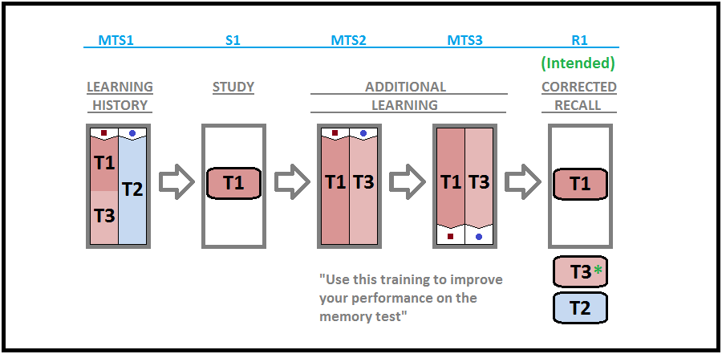
Experiment II: Design and Intended Effects

Slide 13
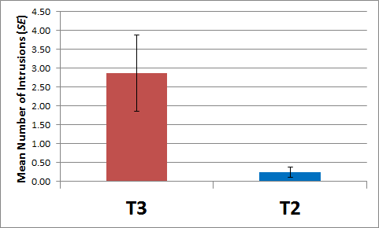
Experiment II: Results
t(7) = 2.74, p = .029, d = 1.29

Slide 14
Why Didn’t the Additional Learning and Instructions Correct the False Memories?
I don’t know. But…
Even though MTS2 and MTS3 didn’t produce retroactive correction,
MTS1 did produce proactive distortion
Perhaps MTS could be used to make a proactive correction?

Slide 15
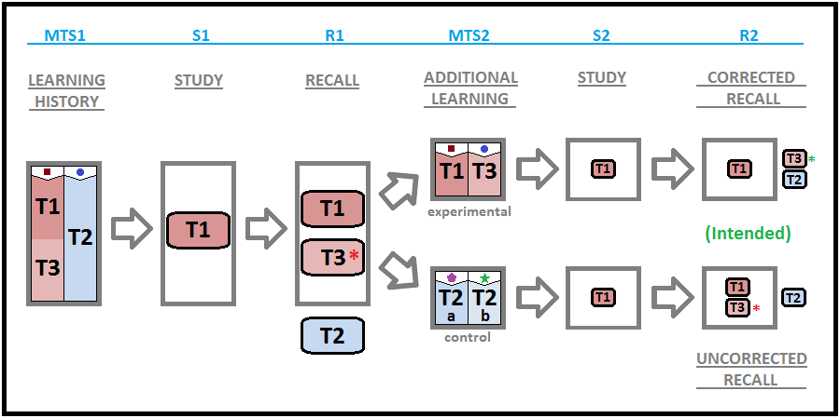
Experiment III: Design and Intended Effects

Slide 16
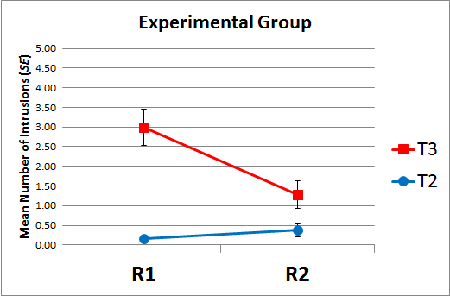
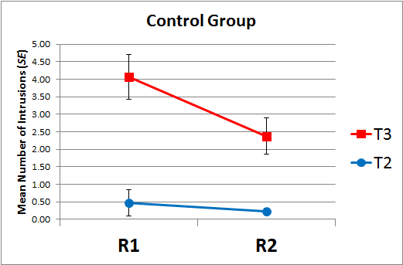
Experiment III: Results
Group x Time x Type of Intrusion
F(1, 35) = .274, p = .604, η_{p}² ⁼ .008

Slide 17
Summary of Findings
The only manipulation that reduced T3 intruding was a second chance (S2) to study the T1 words.
Does a second chance to study T1 words alter the functions of previously intruded T3 words?
Strips remembering functions from T3?
Transforms remembering functions of T3?
Does a second chance to study T1 words overshadow the effects of MTS1?
Increases R2 contextual control over T1 responding?

Slide 18
Question to Research
Class partitioning via MTS does not appear to strip or transform previously acquired functions from sub-classes.
Function transformation between relata in a frame of distinction may occur in the context of newly acquired functions only.

Slide 19
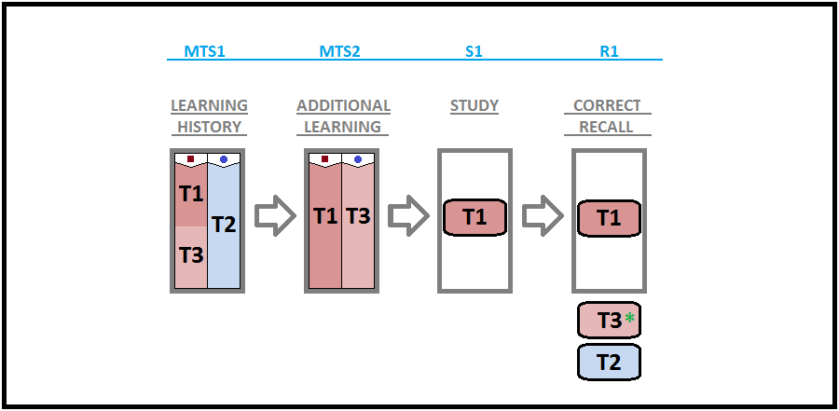
Untested Design…

Slide 20
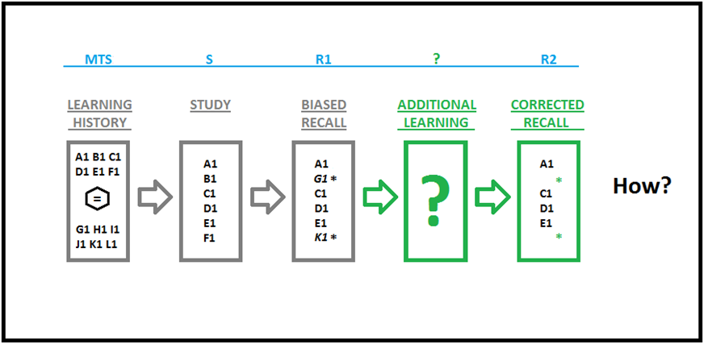
Q&A
Thank You!
pguinther@portlandpsychotherapyclinic.com

Slide 23
MTS1 Training

Slide 24
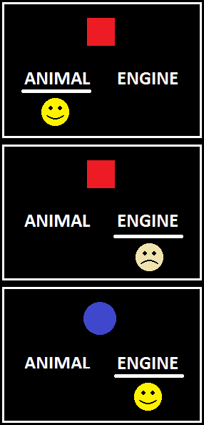
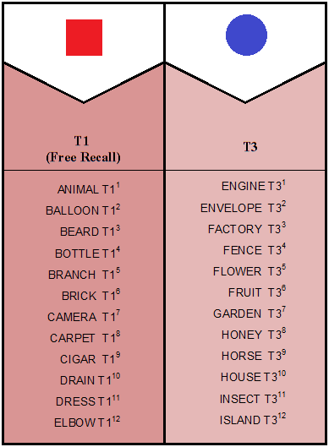
MTS2 Training
Partition A Partition B

Slide 25
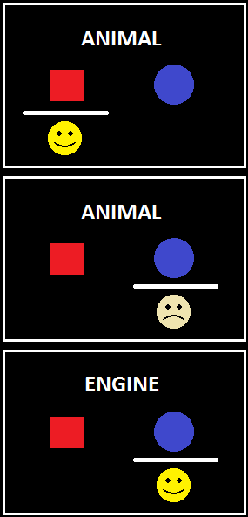
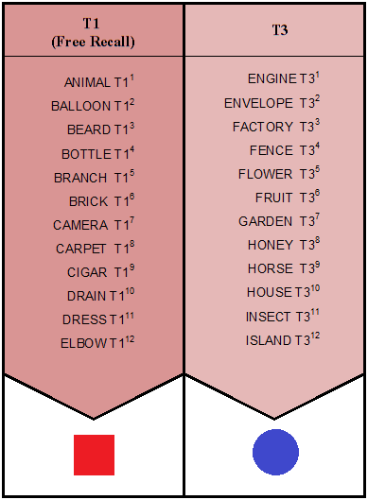
MTS3 Training
Partition A Partition B

Slide 26
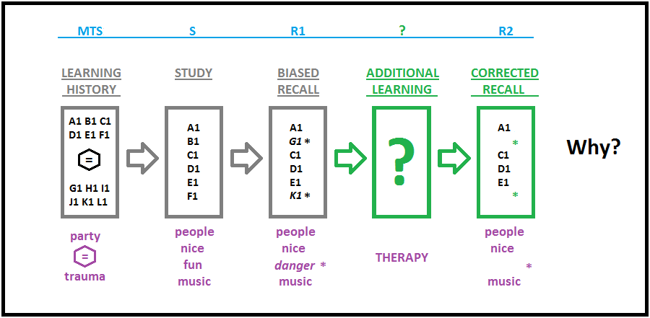
Correcting False Memories

